Slide 1

Let’s start with Allah Yaar
Bs in Computer Science

Slide 2
Introduction to DNS
Definition: DNS (Domain Name System) is like a phone book for the internet. Just as you use names to look up phone numbers, DNS lets you use domain names (e.g., www.google.com) to find IP addresses (e.g., 142.250.190.78 ) This translation is essential because humans prefer names, while machines communicate using numbers.

Slide 3
Introduction to DNS
Purpose of DNS:
Simplifies Internet Navigation: Users don't need to memorize complex numeric IP addresses.
Ensures Seamless Communication: Converts easy-to-remember domain names into technical identifiers like IPv4 and IPv6 addresses.
Facilitates Scalability: Handles billions of domain names globally with its hierarchical design.

Slide 4
Introduction to DNS
Key Components of DNS
Domain Names: Domain names are structured identifiers for internet resources. They are organized hierarchically:
Top-Level Domain (TLD): The last part of a domain, such as .com, .org, .edu
Second-Level Domain (SLD): The name directly before the TLD, like example in example.com
Subdomain: A prefix added to the SLD, such as blog.example.com Subdomains often host separate content.

Slide 5
Introduction to DNS
DNS Servers: The backbone of DNS:
Recursive Resolvers: These servers find the IP address by contacting multiple servers on behalf of the user.
Authoritative Name Servers: Provide definitive answers for specific domains.
Root Servers: Act as the starting point of queries, directing traffic to TLD servers.

Slide 6
Introduction to DNS
Zone Files: Text files stored on authoritative servers that map domain names to IP addresses. For example, a zone file might specify
www.example.com → 192.168.1.10

Slide 7
Introduction to DNS
DNS Hierarchy
Root Level: Represented by a dot (.) this is the topmost level in DNS. Root servers know where to direct queries for TLD servers.
Top-Level Domains (TLDs): Organized categories of domains:
Generic TLDs (gTLDs): Common suffixes like .com, .org
Country-code TLDs (ccTLDs): Specific to countries, like .uk (United Kingdom) or .in (India).

Slide 8
Introduction to DNS
Second-Level Domains: These are registered under TLDs. For example, example is a second-level domain in example.com
Subdomains: Further divide the domain hierarchy for specific purposes, like mail.example.com for email servers.

Slide 9
Introduction to DNS
Types of DNS Servers
Recursive Resolvers: Handle user queries by searching through the DNS hierarchy. They ensure users don’t need to contact multiple servers.
Authoritative Name Servers: Store records for a specific domain and directly resolve queries. For instance, the authoritative server for example.com would provide its IP address.

Slide 10
Introduction to DNS
Root Name Servers
The starting point of DNS resolution. They maintain a database of TLD servers and direct queries accordingly.
TLD Name Servers
Store information about second-level domains for a specific TLD. For example, the .com TLD server knows where to find the authoritative server for s

Slide 11
Introduction to DNS
DNS Resolution Process
Client Query: A user types a domain name (e.g., www.example.com) into a browser, initiating a DNS query.
Recursive Resolver: The client sends the query to a recursive resolver, which starts the search for the IP address.
Root Server Query: The resolver asks a root server, "Where is the TLD server for .com?"

Slide 12
Introduction to DNS
DNS Records
A Record: Maps a domain name to an IPv4 address. For example: www.example.com → 192.168.1.10.
AAAA Record: Maps a domain name to an IPv6 address (e.g., 2401:db00:21:705::1).

Slide 13
Introduction to DNS
DNS Records
CNAME Record: Alias one domain to another. For example: www.alias.com → www.original.com.
MX Record: Specifies the mail server for a domain, ensuring email delivery. For example: mail.example.com.
PTR Record: Performs reverse DNS by mapping IP addresses back to domain names.

Slide 14
Introduction to DNS
DNS Caching
Definition: DNS caching stores resolved queries temporarily to reduce load on servers and improve response time.
Benefits:
Speed: Faster response for repeat queries.
Efficiency: Reduces traffic to DNS servers.
Reliability: Ensures consistent performance even if servers are temporarily unavailable.

Slide 15
Introduction to DNS
DNS Security Issues
DNS Spoofing/Poisoning: Attackers inject false information into DNS records to redirect traffic to malicious websites.
DDoS Attacks: Overload DNS servers with excessive queries, disrupting their functionality.

Slide 16
Introduction to DNS
Mitigation:
DNSSEC (DNS Security Extensions): Adds a layer of security by validating DNS responses.
Firewalls and Monitoring: Prevent unauthorized access and detect anomalies.

Slide 17
Introduction to DNS
Advantages of DNS
User-Friendliness: Eliminates the need to memorize IP addresses.
Scalability: Handles billions of domain names efficiently.
Redundancy: Multiple servers ensure reliability.
Load Balancing: Distributes traffic across servers, improving performance.

Slide 18
Introduction to DNS
Disadvantages of DNS
Vulnerability to Attacks: DNS spoofing and DDoS attacks can compromise its integrity.
Dependency on Infrastructure: Requires reliable servers and networks.
Resolution Delays: High traffic or failures can slow down the query process.

Slide 19
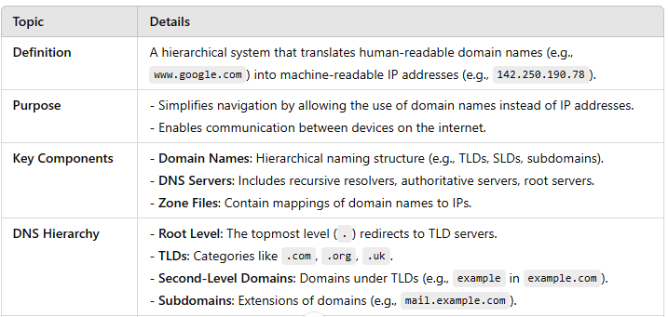
Summary Table

Slide 20
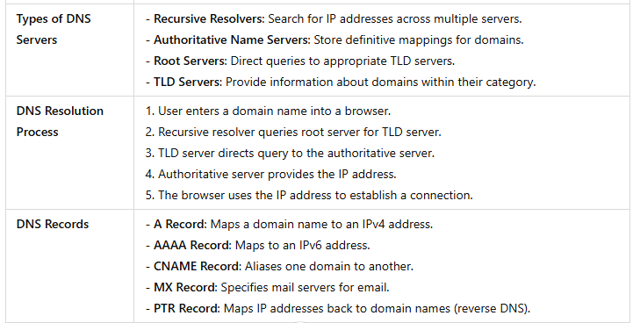
Summary Table

Slide 21
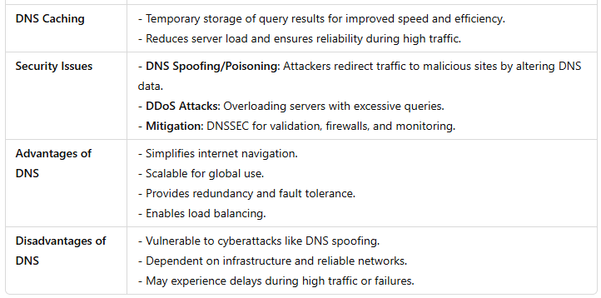
Summary Table

